Slide 1

Face recognition system
User Manual
Author: Condoleezza Agbeko
Notes:
Preworks course home assignments

Slide 2
Table of Contents
Acknowledgements
About me
Journey with clevered
About App
How do I use the app?
Contact person

Slide 3
Acknowledgements
A small vote of thanks for all who have helped me in this journey of App Development – my parents, Mentors,Mr. Ken, Group Members, Friends, Sites etc.

Slide 4
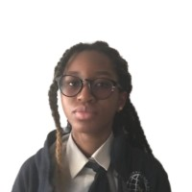
About Me..
Student’s Photograph
Student’s Introduction:
Condoleezza Agbeko
16 years old
Grade 11
Nairobi International School

Slide 5
About App..
App’s Main Menu:
Upload your image
Submit
Your prediction
App’s Introduction:
It is a facial recognition system which can recognise a given image’s face and provide the name of the face if the face matches, if it doesn’t then it will return ‘face not found’.

Slide 6
How do I use the App?

Slide 7
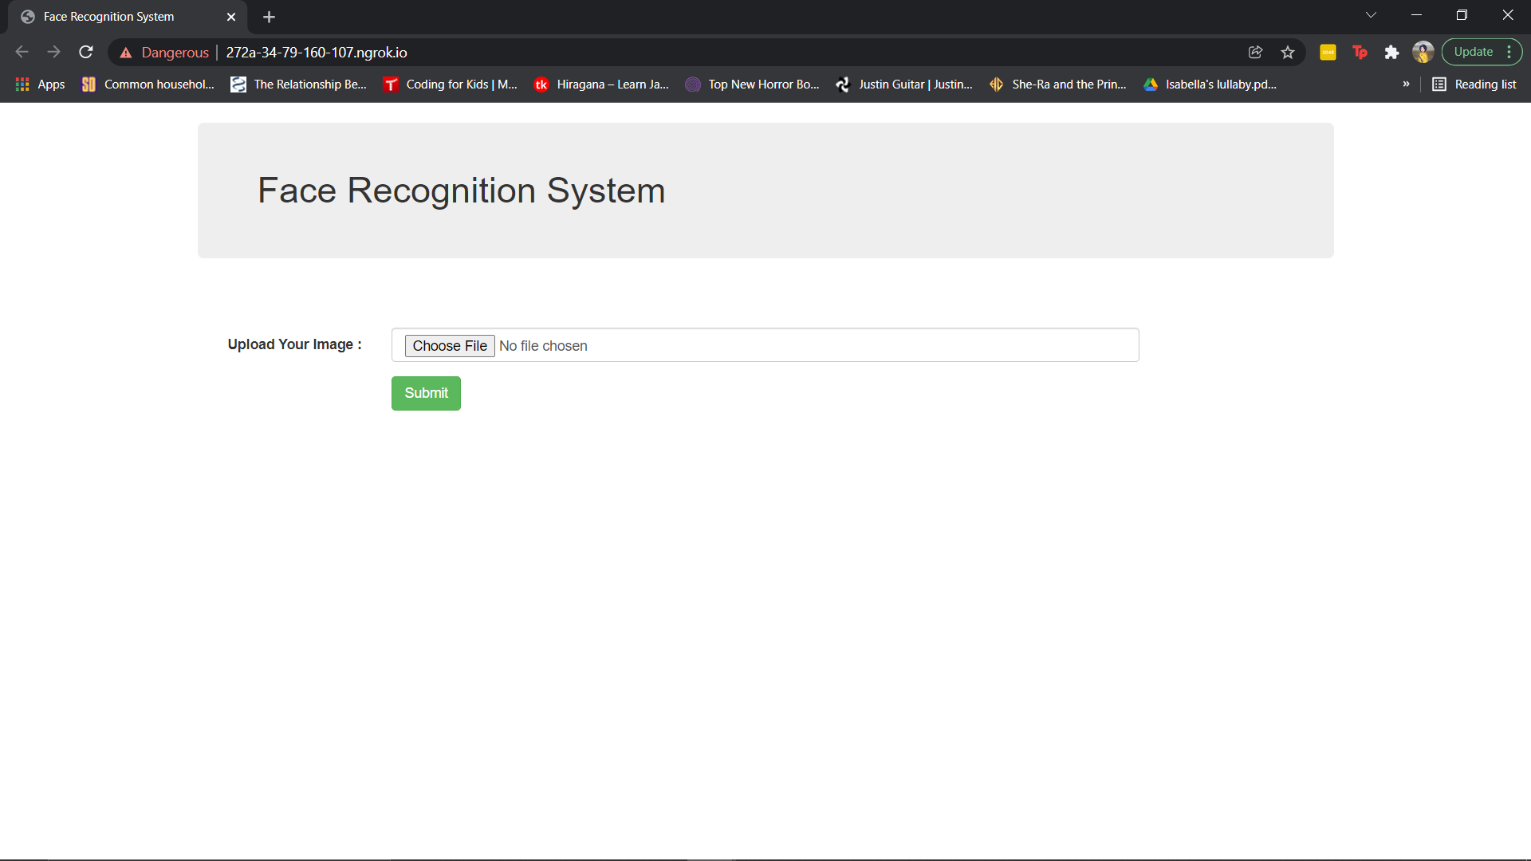
Screenshot/ Pic of each option/screen of the App
Insert a photo of a person.
Press the submit button.

Slide 8
Contact Person
Condoleezza Agbeko
cfagbeko@gmail.com

Slide 9
Thank you!

